Slide 1
Central Line Training 101
Brian Poole, MD
Emily Beck, MD
Brian Locke, MD

Slide 2
Notes:
“The performance of all invasive procedures requires the ability to facilitate an effective discussion with patients regarding risk and benefit of the procedure before obtaining consent, a critical task that all internists must effectively perform. Internists who perform any invasive procedures must be able to initiate a standardized preparation beforehand including hand washing, donning of sterile gloves, preparation of the procedural field, and application of some form of anesthetic. Procedural competence need not be determined solely by a minimum number of successfully completed procedures but may be customized as appropriate through simulation, direct observation, and other criteria determined by the program director and clinical competency committee.”

Slide 3
Objectives
Describe indications, risks, and procedural steps of central line placement
Become familiar with central line kit
Identify vessels using ultrasound to guide central line placement
Practice steps to successfully place a central line

Slide 4
Question 1
Which of the following is NOT an indication for central venous catheter placement?
Massive transfusion
Administration of caustic medications
Total parenteral nutrition
Frequent lab collections

Slide 5
Question 2
Which answer roughly matches the rate of complications from placing a R IJ triple lumen catheter?
Answer | Arterial Puncture | Vascular Injury | Symptomatic DVT | CLABSI | Pneumo-thorax
A | 1% | <0.1% | 1% | 1% | 10%
B | 1% | <0.1% | 10% | 1% | 1%
C | 10% | <1% | 1% | 1% | 1%
D | 10% | <1% | 10% | 10% | 1%

Slide 6
Question 2
Which of the following is the strongest contraindication to placing a central venous catheter?
Uncooperative awake patient
Infection overlying site of catheter placement
Coagulopathy
Recent tpa administration
Wolfe KS, Kress PJ. Chest 2016;150(1):237-246.

Slide 7
Question 3
Which of the following is most correct regarding the risks of central venous catheter placement?
Subclavian placement has the lowest risk of complications
Femoral catheters have a significantly higher rate of DVT
Incidence of pneumothorax is equal between IJ and SC placement
Blood-stream infection is the most common complication of centra-line placement

Slide 8
Question 4
We currently use chlorhexidine (CHG) as the skin antiseptic prior to invasive procedures. Sterilization of the skin with CHG is dependent on:
A. Scrubbing technique
B. Duration of scrubbing
C. Drying time
D. Light activation
Notes:
Recommendation is 2 min of dryi

Slide 9
Background
1929 Dr. Werner Forssman inserted a ureteric catheter through his cubital vein into the right side of his heart
1953 Seldinger technique was first described for arteriography
In the early 2000 approximately 8% of hospitalized patients required central venous access with more than 5 million catheters placed yearly in the US

Slide 10
Case
72 F with DMII presents to the ED with 1 week of progressive cough, dyspnea, and fevers. She recently attended a family wedding where several contacts later tested positive for COVID.
ED: Hypotensive to 76/48 after 2 L IVF, tachycardic to 120s. She has 2 PIVs (20 g R forearm, 22g L hand) and norepinephrine is started at .1 mcg/kg/min prior to arrival to the MICU.
The nurse asks if you are going to place a central line when the patient arrives in the ICU
Notes:
Does she need more access?
What kind?
How do you decide?

Slide 11
Indications for Central Venous Catheters
Inadequate peripheral access
Vasopressors & Vesicants
Hemodialysis
Hemodynamic monitoring
Rapid resuscitation
Notes:
Briefly touch on peripheral pressors

Slide 12
Types of Central Venous Catheters
Triple (Quad) Lumen CVC
Introducer Sheath (Cordis, PSI) & MAC: contains port for PA-catheter or pacer) and 9 Fr (big) infusion port
Dialysis catheter (2 large lumens +/- an additional medication port)
Peripherally-Inserted Central Catheter (PICC; 1-3 lumens)
Tunneled lines (various; iHD, or medications e.g. Hickman)

Slide 13
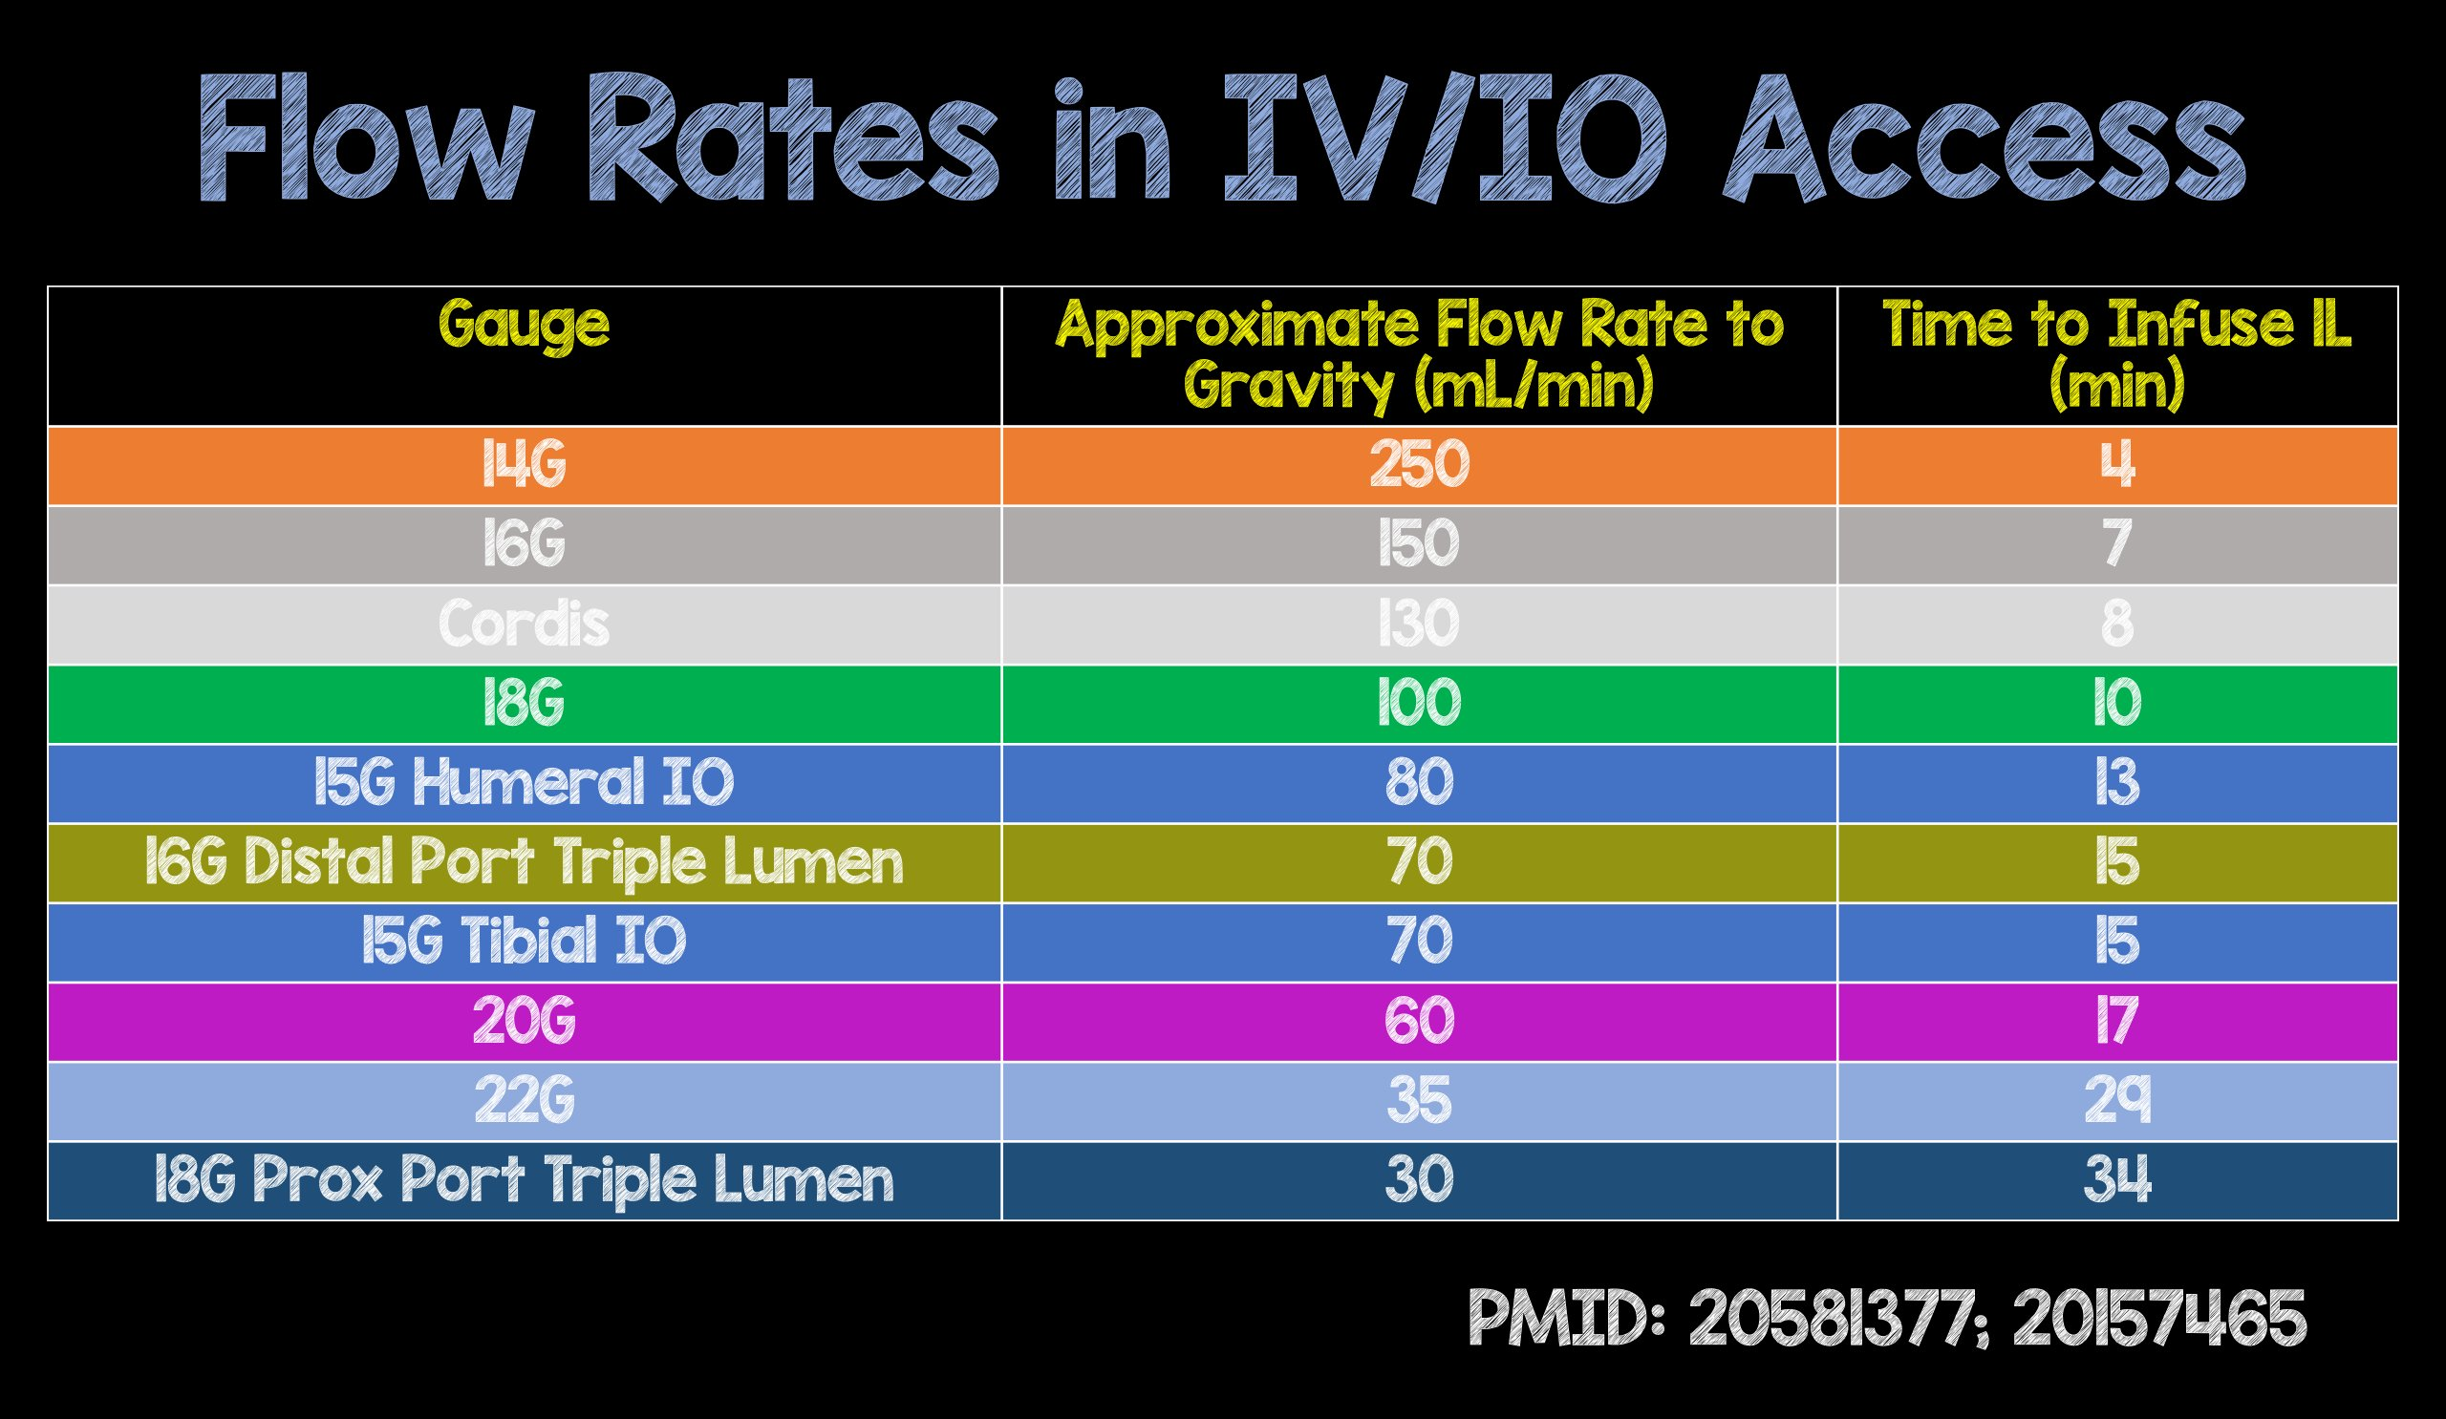
Notes:
https://twitter.com/srrezaie/status/993938864195678209?lang=ar-x-fm
PICC is worse
Colors on that diagram match colors of the PIV

Slide 14
Risks
Bleeding: insertion site, subq/retroperitoneal hematoma, mediastinal, hemothorax
0.5%-1.6%
Infection (i.e. CLABSI)
0.5% - 1.4%- no statistically significant difference between insertion sites*
Vascular injury
4.2-9.3% arterial puncture, <1% arterial injury
Pneumothorax (requiring chest tube)
0.5% IJ
1.5% subclavian
Thrombosis (symptomatic)
0.5% - 1.4% (femoral > IJ ~ subclavian)
Wolfe KS, Kress PJ. Chest 2016;150(1):237-246.
Parienti JJ, et al. New Eng J Med 2015;373(13):1220-1229.
Notes:
Complications: 15% of CVCs; 5 million catheters inserted/yr in US
Bleeding risk related to: anatomical abnormalities, # of needle passes, arterial puncture (3-15%), lack of operator experience, lack of US guidance
IJ: <0.1-2.2%
Subclavian: 0.4-2.1%
Femoral: 3.8-4.4% (arterial puncture, hematoma)
CONFIRM BEFORE DILATING DO PREVENT ARTERIAL DILATION (transduction of cannulated vessel, manometry, pressure waveform analysis, VBG)
U/S guidance reduces risk of arterial puncture, hematoma, hemothorax
Minimal evidence supports routine plt or FFP transfusion (pl 25-50; INR 1.5-3)
3 sites trial concluded lower risk of BSI infection with subclavian but this was a secondary analysis using catheter tip colonization and the rate of clinical BSI was not statistically significant between groups when separated from primary outcome of BSI + DVT
Nice summary at https://www.kwaktalk.org/ramer/central-line

Slide 15
Contraindications
Few strong contraindications
Distorted vessel anatomy- thrombosis, vascular injury
Infection overlying catheter insertion site
Relative contraindications: alternative site
Coagulopathy
Thrombocytopenia
Elevated ICP
Hemothorax or pneumothorax risk

Slide 16
Procedural Order
Consent
Supplies
Position
Set-up
Place line
Post care

Slide 17
Supplies
Central Line
Contains line and most of your supplies
Central Line Kits
Need: Line caps (3), Luer lock syringe, saline flushes NOT sterile
OR towels, extra gown, gauze
Line caddy
Sterile gloves
Ultrasound probe cover
Line dressing

Slide 18
Positioning: Key to Success
Patient
-Flat/Trendelenburg, bed height, head at top of bed
Ultrasound
Table/Equipment
Physician
Nurse
Monitoring

Slide 19
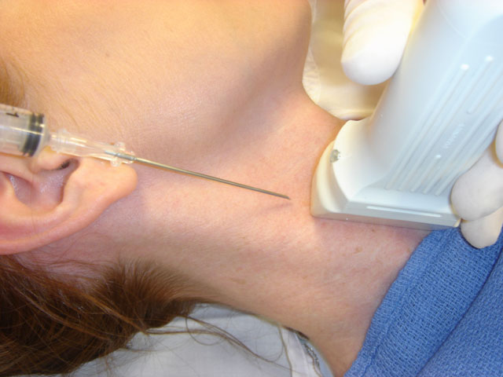
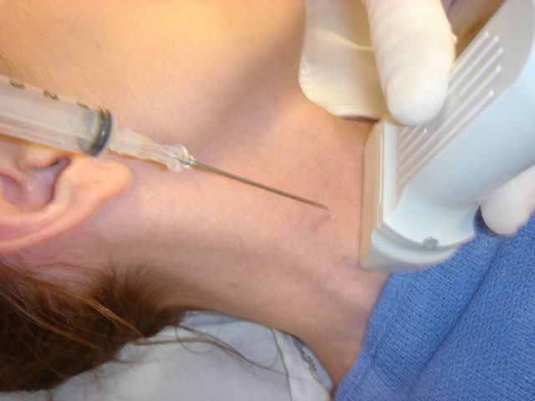
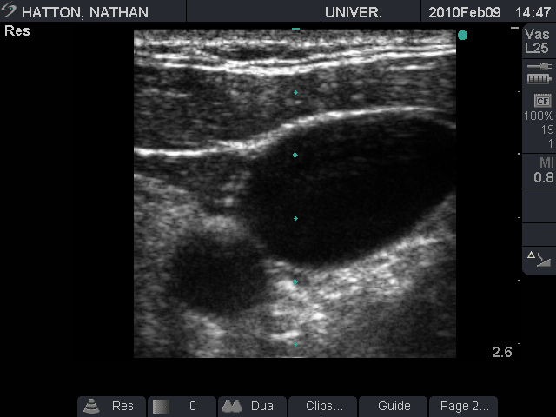
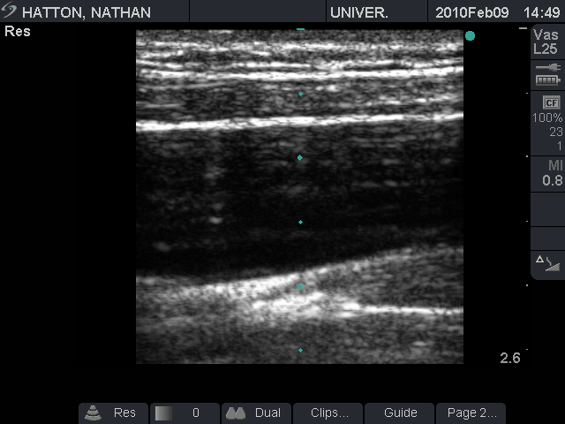
Positioning
Pigott et al. Bedside Ultrasonography, Central Line Placement: Treatment & Medication. eMed Updated: Oct 30, 2009

Slide 20
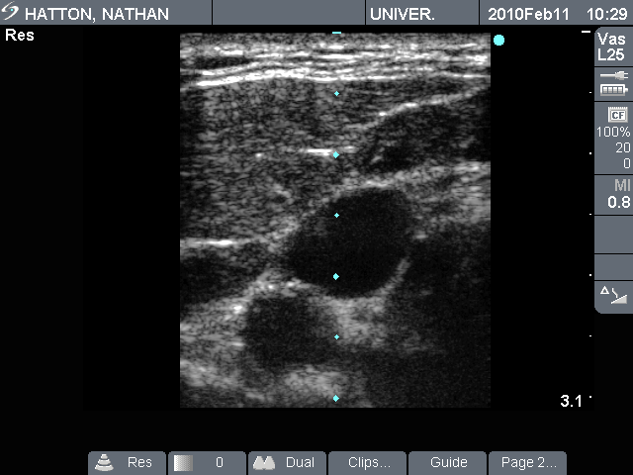
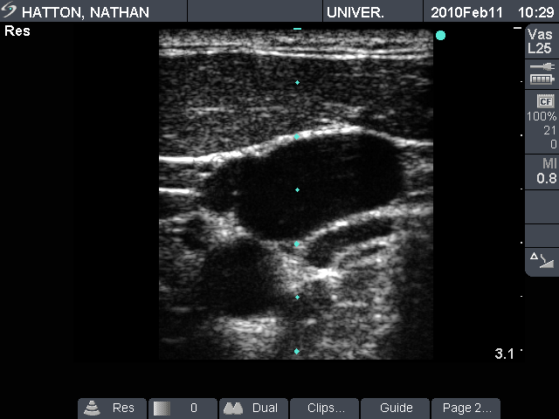
Anatomy
High Neck
Mid Neck

Slide 21
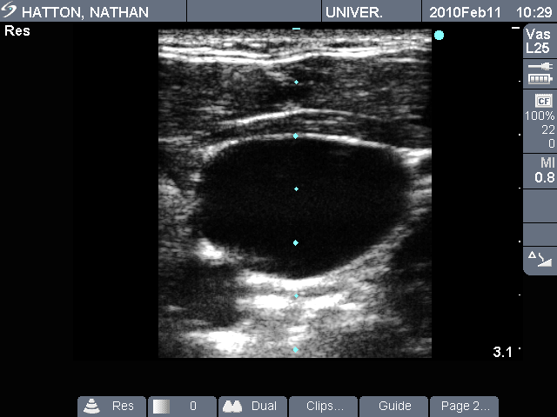
Anatomy
Low Neck

Slide 22
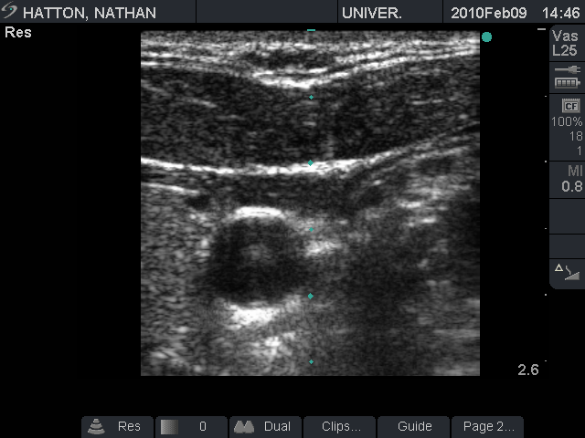
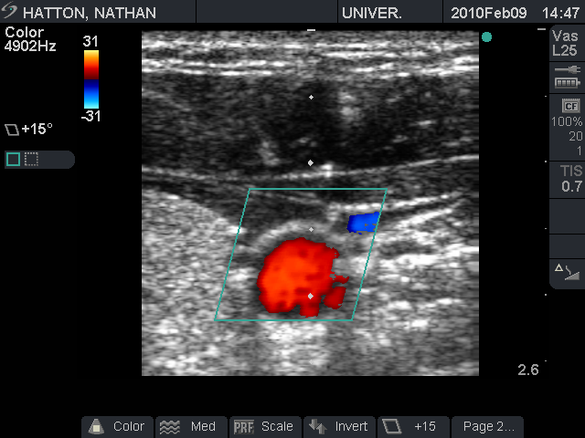
Ultrasound Color Doppler

Slide 23
Always Maintain Sterility
Position patient
Open supplies onto table steriley
Cleanse insertion site with antiseptic
30 seconds drying time
Don sterile gown/gloves
Drape patient
Speak up if you think you might have broken sterile field

Slide 24
Seldinger Technique
https://www.youtube.com/watch?v=hmEMUCaU1y0

Slide 25
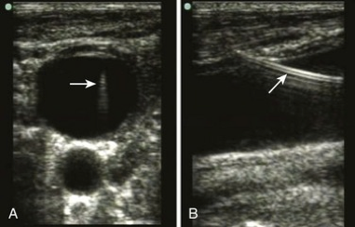
Checking Placement

Slide 26
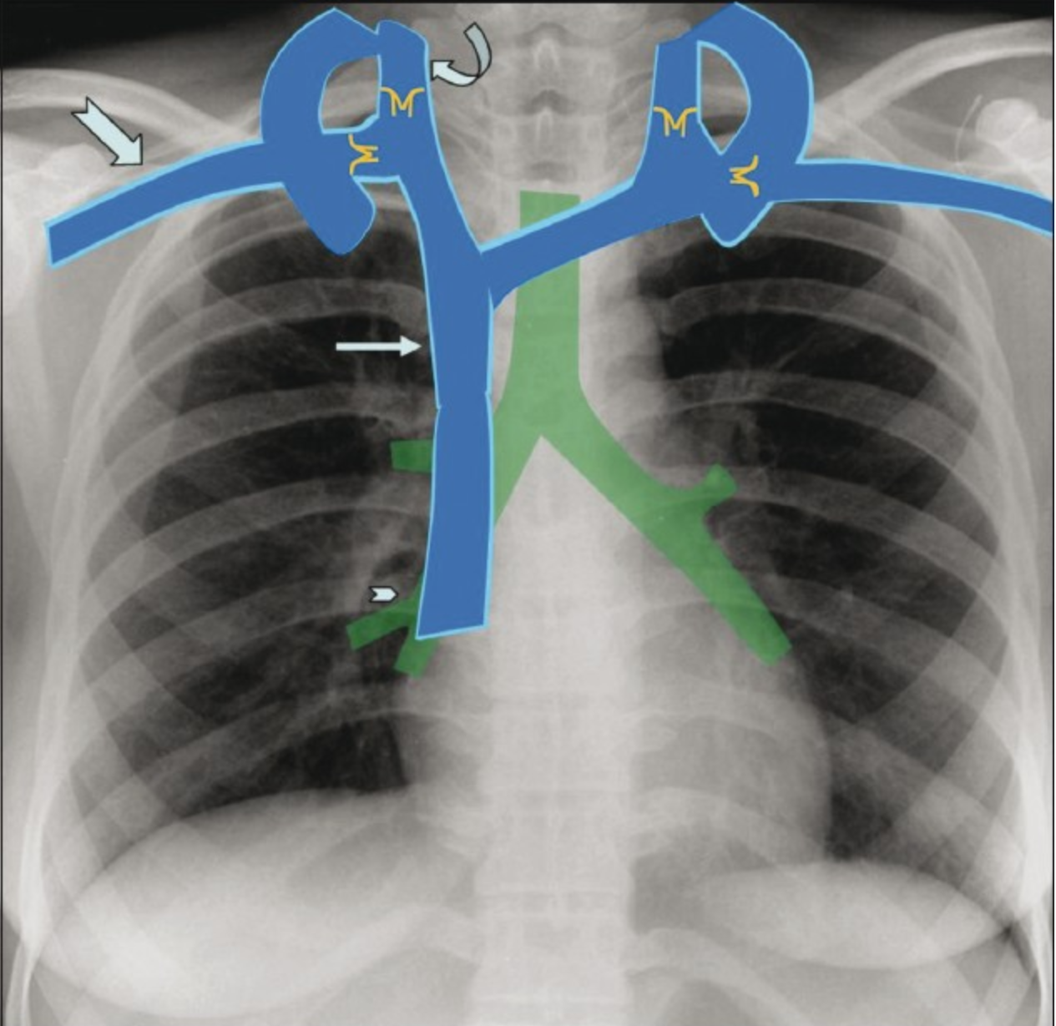
Post procedure: CXR confirmation
Assess correct placement/catheter termination
Cavoatrial junction is 1.5-2 vertebrae below carina
SVC placement is generally fine
Assess for complication
Pneumothorax
Inappropriate vessel
Right side should NOT cross midline
Left side SHOULD cross midline

Slide 27
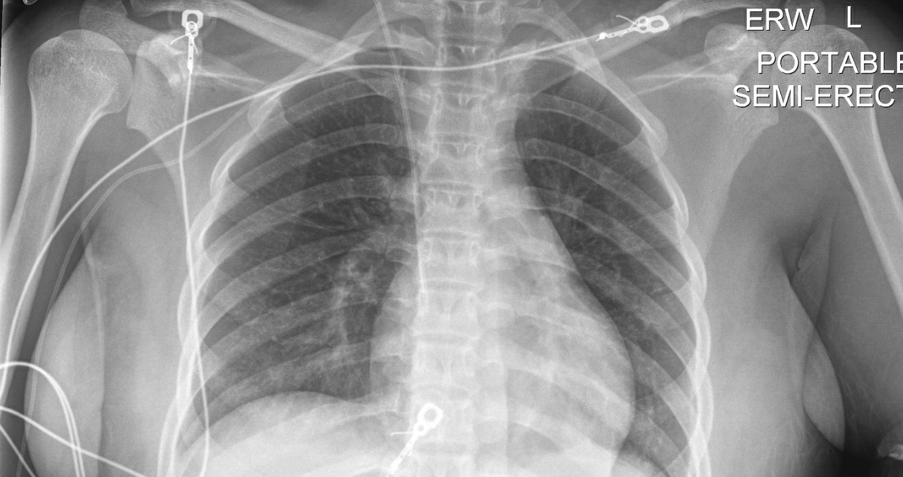
Notes:
Correct positioning

Slide 28
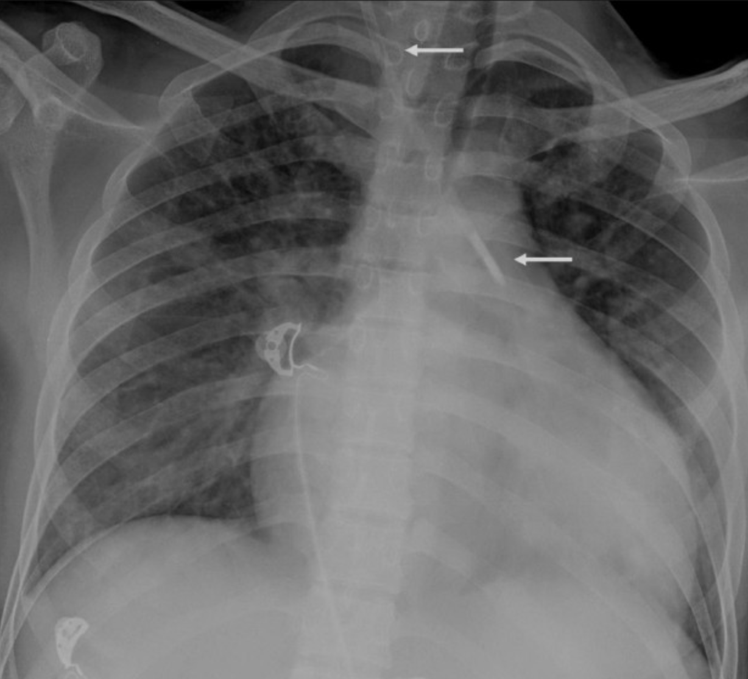
Notes:
Carotid artery cannulation

Slide 29
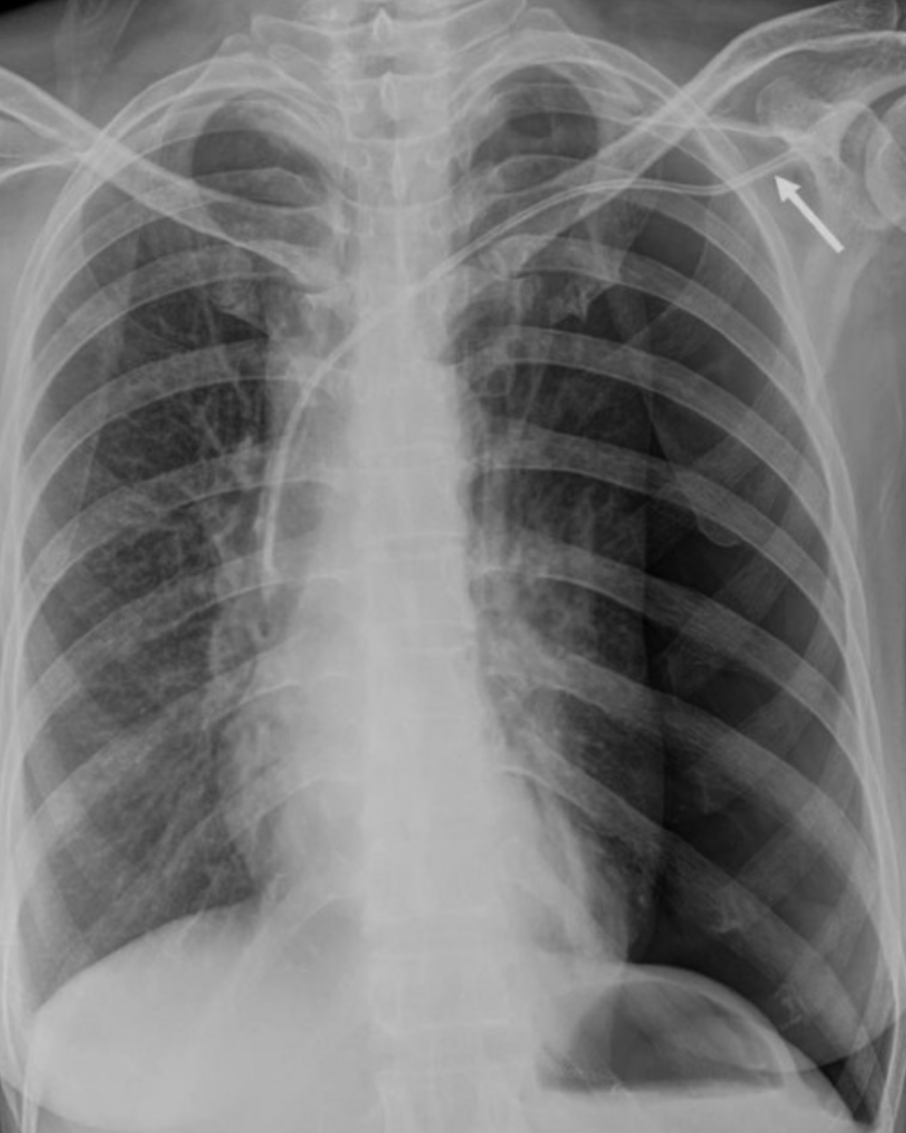
Notes:
pneumothorax

Slide 30
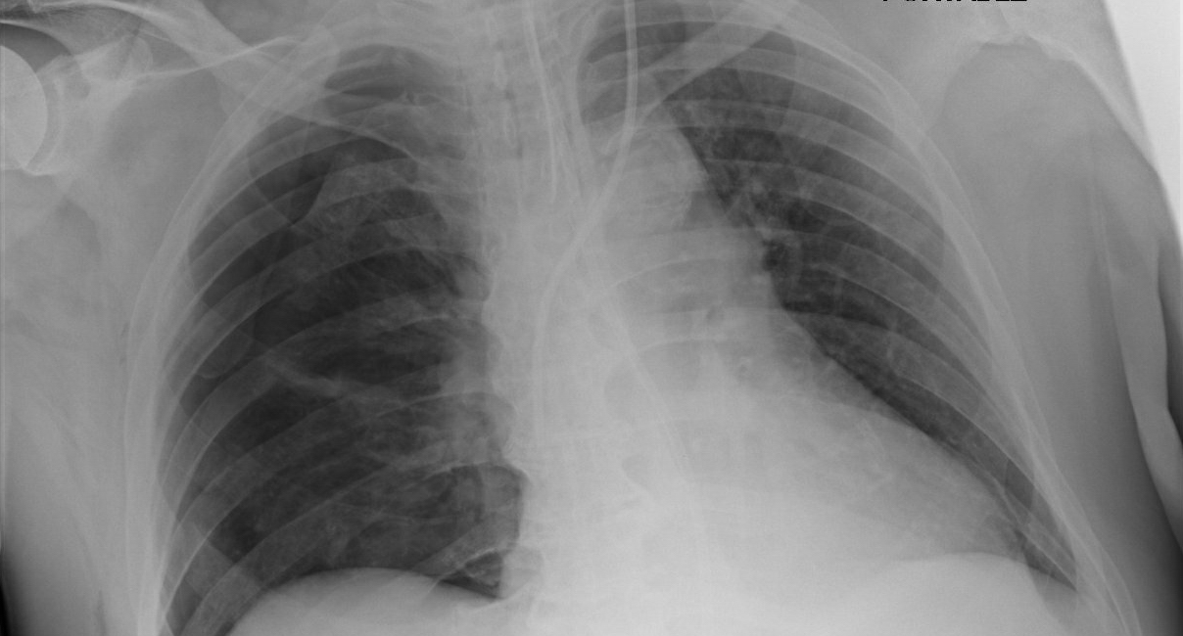
Notes:
Mediastinal hematoma

Slide 31

Post-procedure: Documentation
Notes:
Documentation of all areas where procedures attempted NOT only the successful areas.

Slide 32
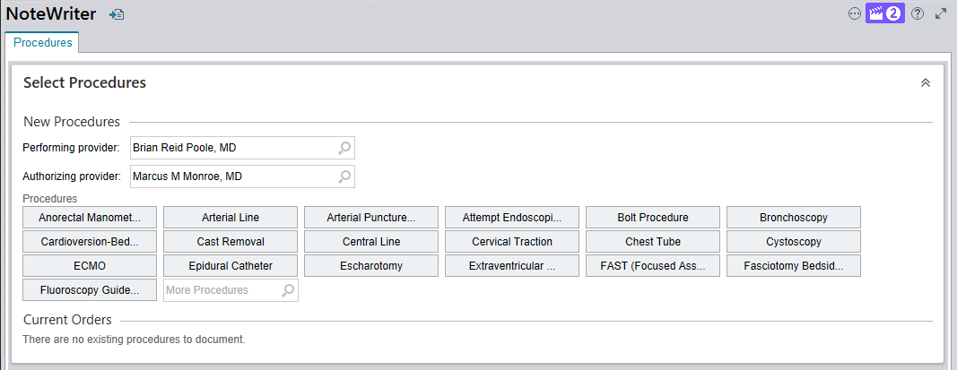
Post-procedure: Documentation
Notes:
Documentation of all areas where procedures attempted NOT only the successful areas.

Slide 33
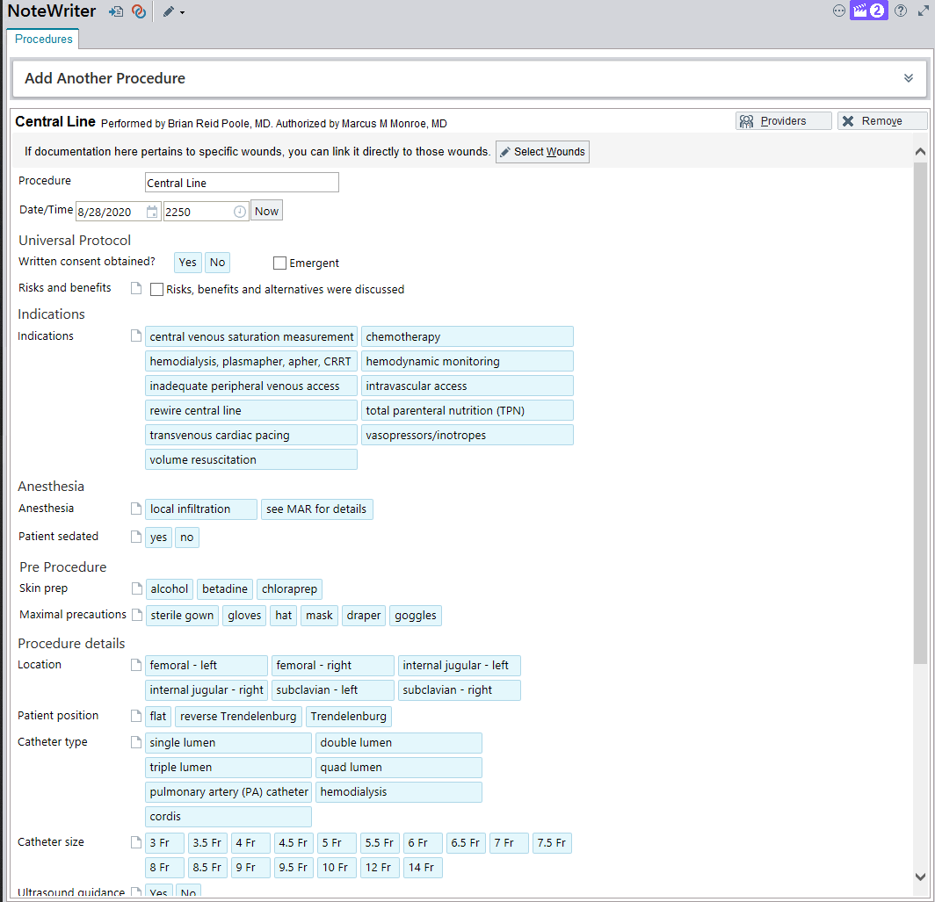
Post-procedure: Documentation
Notes:
Print your procedure notes and place in folder on bulletin board behind work area.

Slide 34
Question
Which of the following is NOT an indication for central venous catheter placement?
Massive transfusion
Administration of caustic medications
Total parenteral nutrition
Frequent lab collections
Labs are not an indication for CVC placement, nor is patient comfort.

Slide 35
Question 2
Which answer roughly matches the rate of complications from placing a R IJ triple lumen catheter?
Answer | Arterial Puncture | Vascular Injury | Symptomatic DVT | CLABSI | Pneumo-thorax
A | 1% | <0.1% | 1% | 1% | 10%
B | 1% | <0.1% | 10% | 1% | 1%
C | 10% | <1% | 1% | 1% | 1%
D | 10% | <1% | 10% | 10% | 1%
Confirm wire placement before dilating!

Slide 36
Question
Which of the following is the strongest contraindication to placing a central venous catheter?
Uncooperative awake patient
Infection overlying site of catheter placement
Coagulopathy
Recent tpa administration
Wolfe KS, Kress PJ. Chest 2016;150(1):237-246.

Slide 37
Question
Which of the following is most correct regarding the risks of central venous catheter placement?
Subclavian placement has the lowest risk of complications
Femoral catheters have a significantly higher rate of DVT
Incidence of pneumothorax is equal between IJ and SC placement
Blood-stream infection is the most common complication of centra-line placement

Slide 38
Question
We currently use chlorhexidine (CHG) as the skin antiseptic prior to invasive procedures. Sterilization of the skin with CHG is dependent on:
A. Scrubbing technique
B. Duration of scrubbing
C. Drying time
D. Light activation
Notes:
Recommendation is 2 min of dryi

Slide 39
Learning Points
You must be able to consent a patient independently for a central line to meet ABIM requirements: know indications and complication rates.
Evaluate each confirmation x-ray: terminates between SVC-Atria?, Crosses Midline?, Pneumothorax?
Never be afraid to admit you broke sterility

Slide 40
Questions?
brian.poole@hsc.utah.edu 801-691-8134
emily.beck@hsc.utah.edu 208-830-6514
brian.locke@hsc.utah.edu 406-570-6919

